Slide 1

CLASSIFYING ELECTORATES
A DATA DRIVEN APPROACH TO PREDICTING ELECTIONS
AND DISCOVERING ELECTORATE VOTING PATTERNS
Peter Rudder

Slide 2

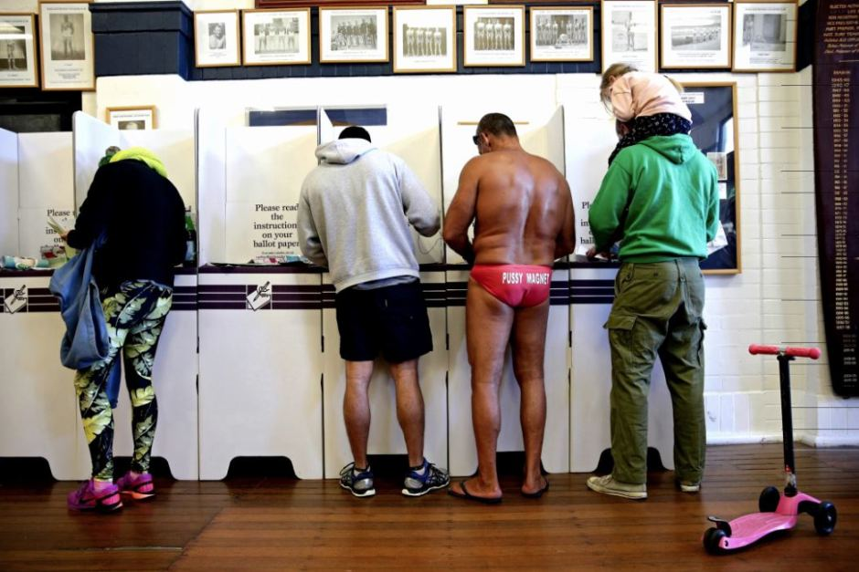
Agenda
Background
Objective
How was the data collected?
What does the model do?
Results & findings
Accuracy of the model
Top predictors
Feature descriptions
Applications
Usage & Deployment
Costs

Slide 3
Objective
To build a model that can classify an Australian Federal Electorate as left or right wing, and can tell us why

Slide 4
OVERVIEW
CONSTRUCT & DOWNLOAD
BUILDING THE DATA BASE
EDA & CLEANING
MODELING & PREDICTING
Download CSVs from ABS/AEC, and clean columns and cells before upload
Create tables based off of CSVs, clean columns and data, then join them all together
Graphing financial, education, cultural statistics by party and state
Building a model that classifies an electorate as left or right wing to predict the 2019 election

Slide 5
Election Data
Demographics Data
Source: Australian Electoral Commission (AEC)
Format: CSV
Method: Simple download from AEC results page
Structure: 35 CSV files, 5 categories for 7 election years
Source: Australian Bureau of Statistics (ABS) Census
Format: CSV
Method: Manual table creation via Table Builder exported to CSV
Structure: 81 CSV files, 27 categories for 3 census years

Slide 6
POSTGRESQL
DATABASE
AEC
ABS
CLEAN/MODIFY
CLEAN/MODIFY
YEAR AND ELECTORATE
INNER JOINED DATA FRAME
Rows : 876
Columns : 290

Slide 7
How does it work?
INPUT 2004-2016 DEMOGRAPHICS
& ELECTION DATA
GENERATE 2019 ELECTION
PREDICTIONS FOR LEFT/RIGHT
LEANING ELECTORATES
INSIGHTS INTO FEATURES THAT ARE LEFT / RIGHT DETERMINANTS

Slide 8
84%
+30%
16FL, 6FR
Results
ACCURACY IN PREDICTING THE 2019 ELECTION
OVER THE BASELINE
FALSE LEFT AND FALSE RIGHT PREDICTIONS OUT OF 141

Slide 9

How each state/territory scored in 2019
NT
25%
QLD
59%
AVG
72%
WA
73%
SA
83%
NSW
79%
ACT
100%
VIC
80%
TAS
76%

Slide 10


Top left
leaning predictors
Top right
leaning predictors
Tram to work
Non-indigenous
Education not stated
Never married
Work in public admin and safety
Not attending education
Work in mining
Not religious
Work in manufacturing
South Eastern European heritage
Work in wholesale trade
Work in retail trade
Finished school up to year 11
Married
Work over 49 hours p/w
Work in real estate
Western European heritage
Mortgage $3000-$3999 p/m
Work in Government/Defence
Mortgage $4000-$4999 p/m

Slide 11
Applications
OBJECTIVITY
Less polling dependent method of predicting future elections
ACCESSIBILITY
Give everyone the means to find out what influences their electorate’s voting patterns
FLEXIBILITY
The data can be used to predict other targets such as seat swing, turnout levels and more election variables, the more data the better the model

Slide 12
Finder.py
Because key words are great for catching your audience’s attention
A quick demonstration for a use case

Slide 13
Finder.py cost estimates
MODEL
DEVELOPMENT
WEB APP DEPLOYMENT
MARKETING
$5,000 - $10,000
Data licensing
$1,500 - $3,000
Free lance web dev + domain hire
$0
Word of mouth &
Social media

Slide 14
Thank you!
Does anyone have any questions?
peterwrudder@outlook.com
+61 430 930 881
linkedin.com/in/peterrudder/

